Slide 1



Modules and Routing
Creating Single-Page Applications
SoftUni Team
Technical Trainers
Software University
https://softuni.bg

Slide 2
Table of Contents
The NgModule
Creating your own modules
Routing Overview
Router Module
Links, Redirects, Query Params
Router Guards
2

Slide 3
Have a Question?
sli.do #js-web

Slide 4

The NgModule
Building Blocks of the Application

Slide 5
Angular Modules Overview
NgModules help organize an application into cohesive blocks of functionality
An NgModule is a class decorated with @NgModule
Many Angular libraries are NgModules
FormsModule, HttpClientModule, RouterModule
Many third-party libraries are available as NgModules
Material Design, Ionic, Angular Fire
import { NgModule } from '@angular/core';

Slide 6
Creating Custom Modules
Creating you own modules is useful when the application grows
Only the root module should contain BrowserModule
All custom-made modules should import CommonModule
Custom made modules have exports array
Components added in declarations are private by default
This is done because of reusability
import { CommonModule } from '@angular/common';

Slide 7
Creating Custom Modules (2)
import { NgModule } from '@angular/core';
import { CommonModule } from '@angular/common';
@NgModule({
imports: [ CommonModule ],
declarations: [
CustomerListComponent,
CustomerDetailsComponent ],
exports: [ CustomerListComponent ],
providers: [ CustomersService ]
})
export class CustomersModule { }
Export to render outside this module
7

Slide 8
Suggested Common Module
Shared Module - to contain all common components, directives and pipes used by a lot of places
Core Module - to contain singleton services and components needed only once in the application
Authentication Module (Register, Login, Logout)
Feature Module - to contain feature specific components
More info: https://angular.io/guide/ngmodules

Slide 9
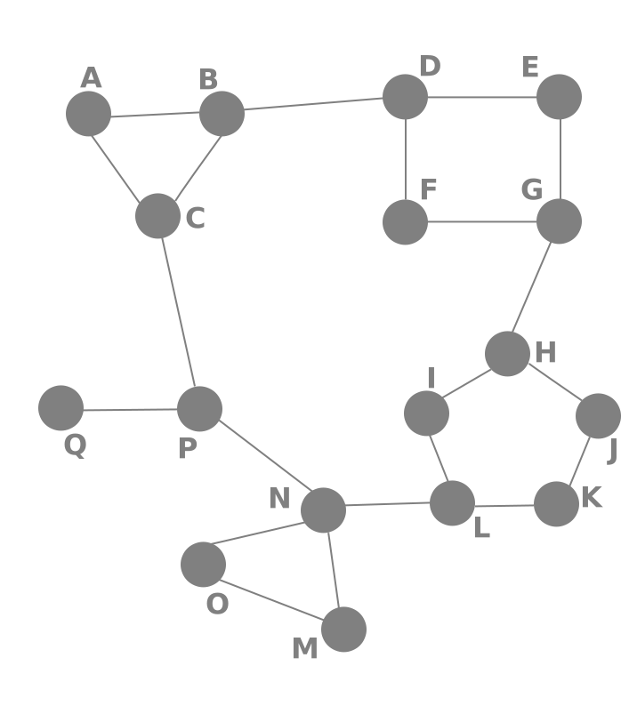
Routing Concepts
Navigation for Single Page Applications

Slide 10


What is Routing?
Allows navigation, without reloading the page
Pivotal element of writing Single Page Applications
HTML
HTML
HTML
Link
HTML
HTML
ROUTER
Link
HTML
HTML
HTML
HTML
Link
Standard Navigation
Navigation using Routing
10

Slide 11

Single Page Applications
A Router loads the appropriate content when the location changes
E.g. when the user manually enters an address
Conversely, a change in content is reflected in the address bar
E.g. when the user clicks on a link
Benefits
Load all scripts only once
Maintain state across multiple pages
Browser history can be used
Build User Interfaces that react quickly

Slide 12

Router Module
Setup, Links, Redirects, Parameters

Slide 13
Define the Template
First add the base meta tag into the index.html file
Add a nav tag so the user can navigate through the app
Define the router outlet where the content will be rendered
<base href="/">
Usually added by the CLI
<nav>
<a routerLink="/home">Home</a>
<a routerLink="/about">About</a>
</nav>
Use routerLink instead of href
<router-outlet></router-outlet>

Slide 14
Create Routes Module
Import NgModule, RouterModule and Routes
Define the needed routes as an array of objects
import { NgModule } from '@angular/core'
import { RouterModule, Routes } from '@angular/router';
const routes: Routes = [
{ path: 'home', component: HomeComponent },
{ path: 'about', component: AboutComponent }
]
'/' is omitted

Slide 15
Create Routes Module
Define the App Routes Module using the decorator
@NgModule({
declarations: [
HomeComponent,
AboutComponent
],
imports: [ RouterModule.forRoot(routes) ],
exports: [ RouterModule ]
})
export class AppRoutesModule { }
Registers all app routes (done only once)

Slide 16
Create Routes Module (3)
Finally import the routes module in app module
import { AppRoutesModule } from './routes.module.ts'
// Other imports for core module
@NgModule({
declarations: [ AppComponent ],
imports: [
BrowserModule,
AppRoutesModule,
],
})
export class AppModule { }

Slide 17
The RouterLink Directive
A basic usage of the RouterLink directive
Bind to the directive a pass an array of parameters
<a routerLink="/user/profile">Profile Page</a>
<a
[routerLink]="[ '/user', 1, 'profile' ]">
Profile Page
</a>

Slide 18
Navigate Programmatically
Inject the Angular Router in components
Use it to navigate from one component to another
constructor(
private router: Router
) { }
From "@angular/router"
loadData() {
// Service call goes here
this.router.navigate([ '/home' ])
}

Slide 19
Passing Parameters to Routes
Define routes with parameters the following way
Nested parameters
{ path: 'user/:id', component: UserDetailsComponent }
{
path: 'user/:id/:username',
component: UserProfileComponent
}

Slide 20
Fetching Parameters
Inject ActivatedRoute in components
Retrieve parameters directly from the snapshot
constructor(
private route: ActivatedRoute
) { }
ngOnInit() {
const id = this.route.snapshot.params['id'] }
Only runs one time when the component is initiated

Slide 21
Fetching Parameters Reactively
To change the content of a component inside the same one use an Observable instead
ngOnInit() {
this.route.params
.subscribe((params: Params) => {
const id = params['id'] }
) }

Slide 22
Query Strings and Fragments
To pass query parameters/fragments attach directives
Retrieve them from the snapshot
<a
[routerLink]="[ '/users', user.id, user.name ]"
[queryParams]="{ search: 'Peter' }"
fragment="loading"
</a>
this.route.snapshot.queryParams
this.route.snapshot.fragment

Slide 23
Setting Up Child (Nested) Routes
Create nested routing by defining child routes using the children property of a route
New router outlet needed at UsersComponent
{
path: 'users', component: UsersComponent, children: [
{ path: ':id', component: UserComponent },
{ path: ':id/details', component: UserDetailsComponent }
]
}
<router-outlet></router-outlet>

Slide 24
Using Wildcards and Redirects
If the requested URL doesn't match any paths for routes, show a 404 Not Found Page
This is done by using a wildcard '**'
To redirect from one path to another
{ path: '**', component: PageNotFoundComponent }
{ path: '', redirectTo: 'home', pathMatch: 'full' }
Telling the router how to match a URL to the path of the route

Slide 25

Router Guards
Protecting Routes

Slide 26
Guards Overview
Limiting access to a route is needed in every application
In Angular there are route guards
Build a guard service
Register the service in an Angular module
Add the guard to a desired route
26

Slide 27
CanActivate Guard
The CanActivate guard checks criteria before activating a route
It limits route access to specific users (register users, admins..)
Called when the url changes
import { Injectable } from "@angular/core";
import {
Router, CanActivate,
ActivatedRouteSnapshot,
RouterStateSnapshot
} from "@angular/router";

Slide 28
Guard Example
Create a guard that restricts non-authenticated users
@Injectable()
export class AuthGuard implements CanActivate {
canActivate(
route: ActivatedRouteSnapshot,
state: RouterStateSnapshot) : boolean {
return this.checkIfLogged(state.url);
}
checkIfLogged(url : string) : boolean {
// Use the authentication service
}
}}

Slide 29
Angular Router Resolver
The Angular Router provides a resolve property
It takes a route resolver and allows your application to fetch data before navigating to the route
path: 'users', component: ServersComponent, children: [
{
path: ':id',
component: UserDetailsComponent,
resolve: { user: UsersResolver }
}
]
29

Slide 30
Implement the Resolver
Create the Resolver Guard
@Injectable()
export class UserResolver implements Resolve<User> {
resolve(route: ActivatedRouteSnapshot,
state: RouterStateSnapshot) {
return this.usersService.getUserById(route.params['id']);
}
}
Inject the service inside the guard

Slide 31
Use It Inside a Component
Inside a Component fetch the data from the data property of the snapshot
constructor (
private route: ActivatedRoute
) { }
ngOnInit() {
this.user = this.route.snapshot.data['user'];
}
The name bound inside the route resolver

Slide 32

Summary
NgModules help organize an application
Routing allows navigation without reloading the page
The Router Module in Angular is a powerful tool
It supports routing with params, child routes, route guards, resolvers and more
import { NgModule } from '@angular/core'

Slide 33
Questions?
Notes:
33

Slide 34













SoftUni Diamond Partners

Slide 35


Educational Partners

Slide 36
Trainings @ Software University (SoftUni)
Software University – High-Quality Education, Profession and Job for Software Developers
softuni.bg, softuni.org
Software University Foundation
softuni.foundation
Software University @ Facebook
facebook.com/SoftwareUniversity
Software University Forums
forum.softuni.bg
36
Notes:
36

Slide 37

License
This course (slides, examples, demos, exercises, homework, documents, videos and other assets) is copyrighted content
Unauthorized copy, reproduction or use is illegal
© SoftUni – https://softuni.org
© Software University – https://softuni.bg
Notes:
37

